Slide 1
Maven Airline Satisfaction Analysis Enhancing Customer Experience Through Data Insights
Date:- 27-03-2024
Presented By
Viki P. Yeole

Slide 2
Introduction to Maven Airline
Maven Airlines is US based airline company .
The director of operations would like to understand why for the last 3 months, the airline has not been making their usual amount of monthly profit.
She would like to understand why for the last 3 months, the airline has not been making their usual amount of monthly profit & also like to know why they have few people buying both Economic class and Economic Plus tickets
Stakeholders:
Director of Operations - Sandra Watson
Group C.E.O of Maven Airlines

Slide 3
Objectives of Analysis
1. Identify the business task:
The director of Operation wants to know why they have few people buying both Economic class and Economic Plus tickets.
She would also like to know which Services have pleased or displeased passengers in all 3 classes.
The director wants to know the reason for the low profit margin for the last 3 months & also want to ensure that low margin is because of services provided or something else.
2. The Business Task:
Perform an analysis with the use of a dataset from the customer relations department to identify the trend patterns that show whether passengers are satisfied with the airline services and providing practical solution if needed.

Slide 4
Data Sources
Data was collected from Maven analytics website in the form of EXCEL.
Data contain 13000 records and 21 columns
Those columns was Id, Gender, age, Customer_Type, Type of Trvel, Customer_Class, Flight distance, Departure delay, arrival delay, Satisfaction/not
Other 12 columns are mentioning about services rated from 0 to 5. FoodDrink, Cleanliness,onlineboarding, seatcomfort, easeofonlinebooking, baggagehandling, checkinservice, inflightservice, inflightentertainment, inflightwifiservice, departure_arrival time convenient are those 12 columns
Columns | Values
Gender | Male, Female
Customer_Type | Loyal , Disloyal
Type of Travel | Business Travel, Personal Travel
Customer Class | Business, Economy, EcoPlus
Satisfaction | Satisfied/ not Satisfied

Slide 5
Data Cleaning and Modelling
Using Conditional Formating and IF statement from DAX Below changes are made.
Converted Age into Age_Group Column Like <10 years, <25 years, <40 years, <55 years, <75 years
Converted Flight_distance in the range <500km, <1000km, <2000km, <3000km, <4000km, >4000km
FoodDrink, Cleanliness,onlineboarding, seatcomfort, easeofonlinebooking, baggagehandling, checkinservice, inflightservice, inflightentertainment, inflightwifiservice, departure_arrival time convenient are those 12 Services provided by airline so converted 0-2 rating into Low, 3 rating to medium and 4-5 rating into high.

Slide 6
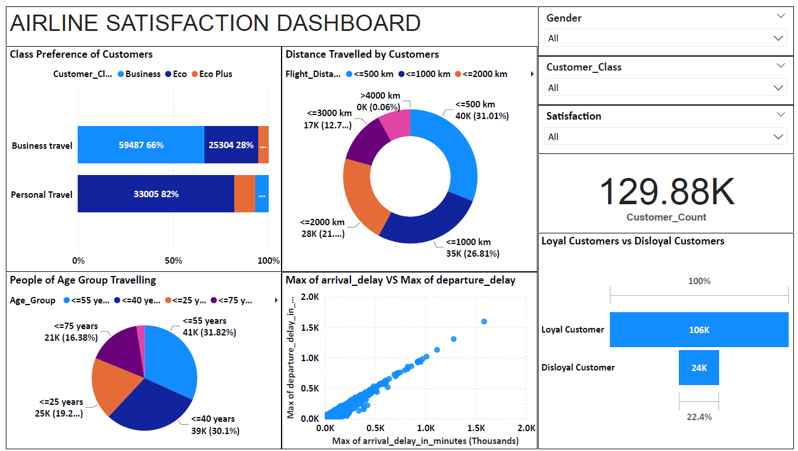
Data Insights

Slide 7
Data Analysis
People Travelling by Eco Class are more dissatisfied by Facilities provided while Business Class is well satisfied.
Customers of age group 26- 40 years are much dissatisfied by Facilities provided .
Customers travelling by ECO-Class are more dissatisfied.
There are around 73K People who are dissatisfied with facilities provided but out of these, 55 k are still loyal with our Company.
People are Satisfied with baggage handling, Inflight_Service, Seat_comfort, Cleanliness and departure arrival Time convenient.
People are Dissatisfied by Inflight wifi service, Online booking, Food_drink_Quality, Online boarding.

Slide 8
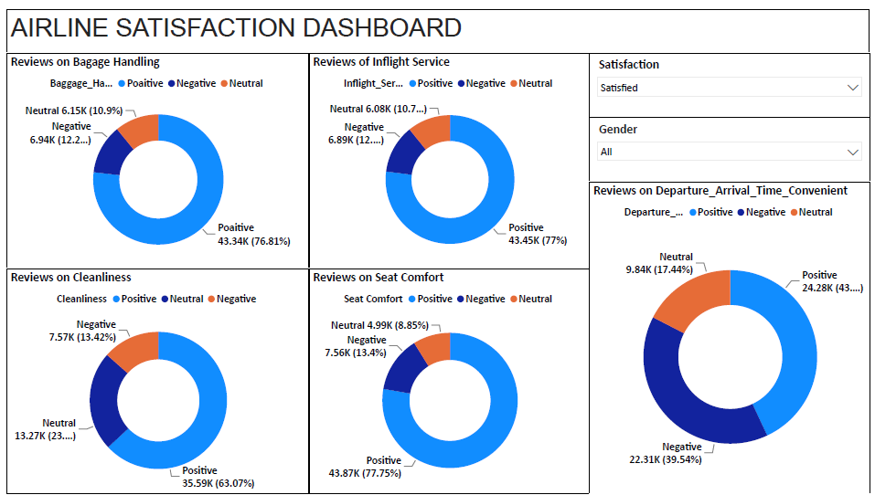
Factors Affecting DisSatisfaction

Slide 9
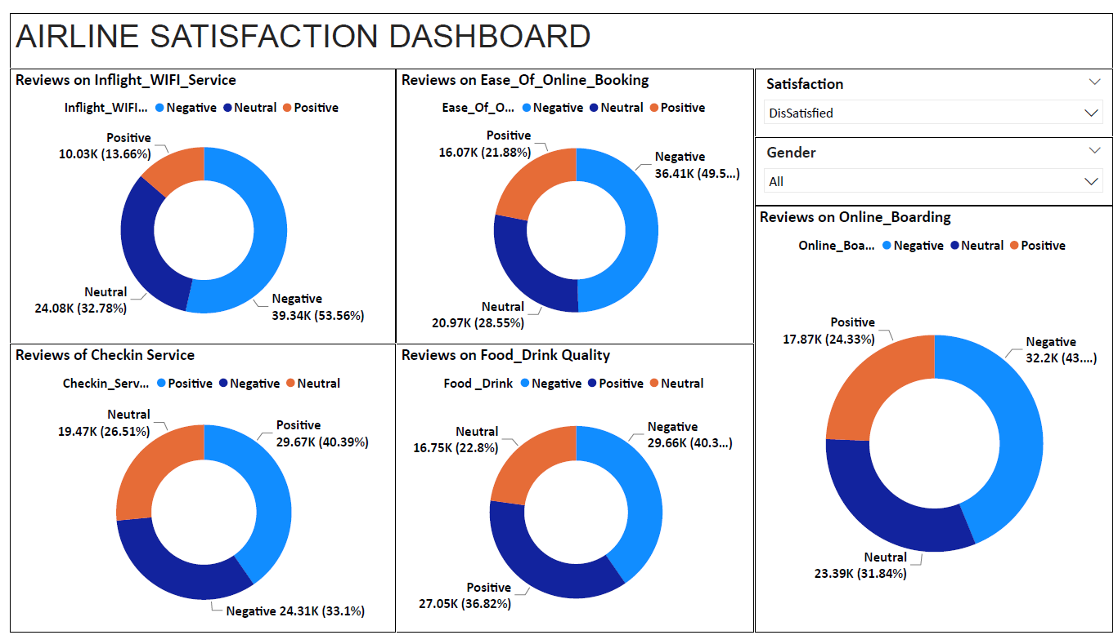
Factors Affecting Satisfaction

Slide 10
Recommendation
Facilities of Eco Class should be improved.
There are around 73K People who are dissatisfied with facilities provided but out of these, 55 k are still loyal with our Company. So for Such customer there should be some discount. and require to take proper action on their facilities.
People are Dissatisfied by Inflight wifi service, Online booking, Food_drink_Quality, Online boarding. Wifi service should be repaird and softwares for online booking and boarding should be updated. Food and drink quality should improved.
Also from Statistics it is found that if checking service is also require to improve on priority basis as Positive and negative reviews are closer.

Slide 11
Thank you

